Slide 1
Chapter 3 Intensity Transformation and Spatial Filtering
Part 3 Spatial Filtering

Slide 2
3.4 Fundamentals of Spatial Filtering
 | Linear | nonlinear
smooth | Smooth Linear Filters | Smooth nonlinear Filters
Sharpening | Sharpening Linear filters | Sharpening nonlinear filters

Slide 3
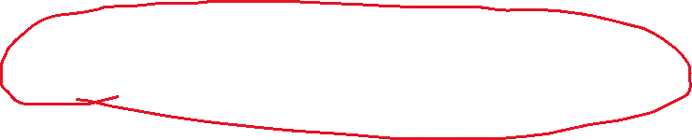
3.4 Fundamentals of Spatial Filtering
float r = 0;
for (int m=-M;m<=M;m++)
for (int n=-N;n<=N;n++)
{
r+=f[x+m,y+n]*mask[M+m,N+n];
}
g[x,y]=S(r);

Slide 4
Fundamentals of Spatial Filtering
0 | -1 | 0
-1 | 5 | -1
0 | -1 | 0
*
 | 5 | 5 | 4
 | 4 | 7 | 4
 | 4 | 4 | 3
 |  |  |  |  |  | #
*0 | *-1 | *0
*-1 | *5 | *-1
*0 | *-1 | *0

Slide 5
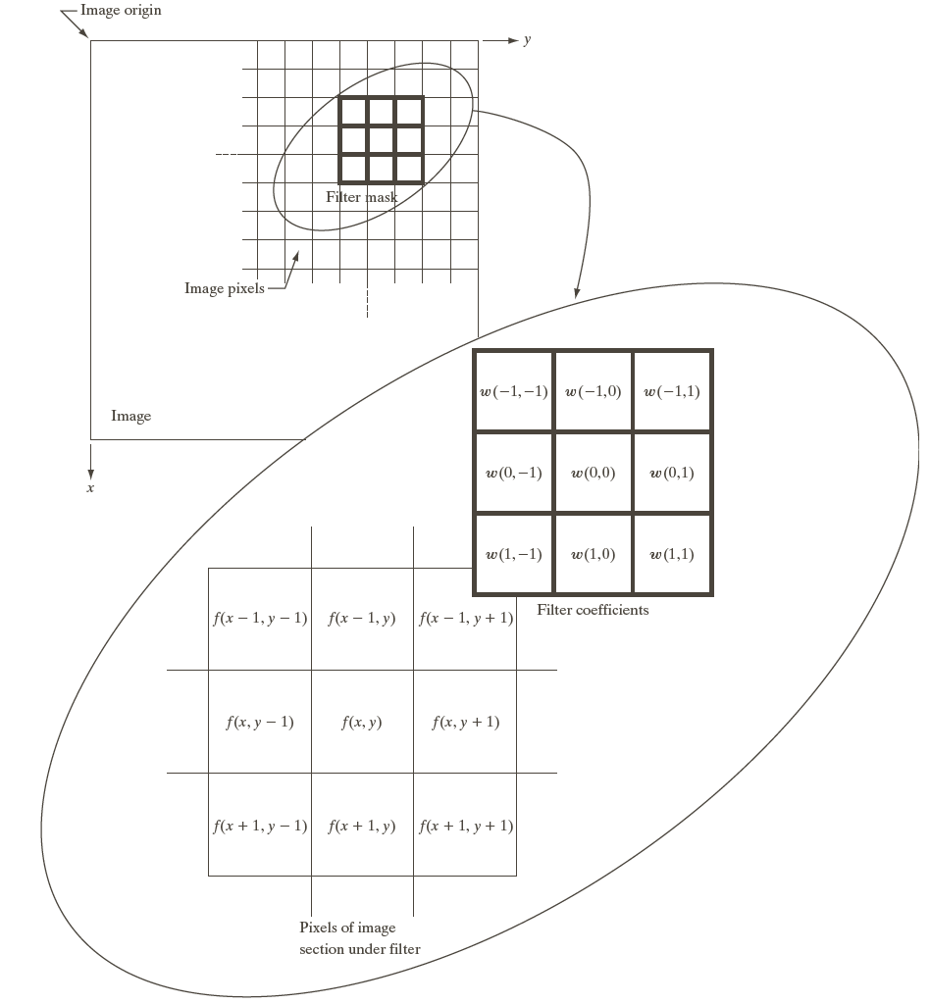

Slide 6
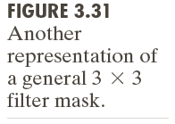
3.4 Fundamentals of Spatial Filtering

Slide 7
3.5 Smoothing Spatial Filters
3.5.1 Smoothing Linear Filters

Slide 8
3.5.1 Smoothing Linear Filters

Slide 9





Slide 10

Directional Blur
0.2 | 0.2 | 0.2 | 0.2 | 0.2
0.2
 | 0.2
 |  | 0.2
 |  |  | 0.2
 |  |  |  | 0.2
0.2
0.2
0.2
0.2
0.2

Slide 11
3.5.1 Smoothing Linear Filters
[Programming of average filter]
Gaussian Blur
Mask(x,y) =G(x,y)=exp(-(x*x+y*y)/(2*r*r)
How to make a Gaussian Filter Mask
(1) Sampling: G(x,y) = G[m,n];
(2) Normalized
s = ∑ G[m,n], G[m,n] = G[m,n]/s
[Programming of Gaussian Blur]

Slide 12

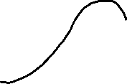


Slide 13




Slide 14
*0 | *-1 | *0
*-1 | *5 | *-1
*0 | *-1 | *0
f[0,0] | f[1,0] | f[2,0] | …
f[0,1] | f[1,1] | f[2,1] | …
f[0,2] | f[1,2] | f[2,2] | …
…

Slide 15


3.5.2 Order-Statistic (Nonlinear) Filters
Median Filter
Median Filters are particularly effective in the presence of impulse noise (also called salt-and pepper noise)
Salt and pepper noise
Random location;
Independent value;
[Programming of Salt and pepper noise]

Slide 16
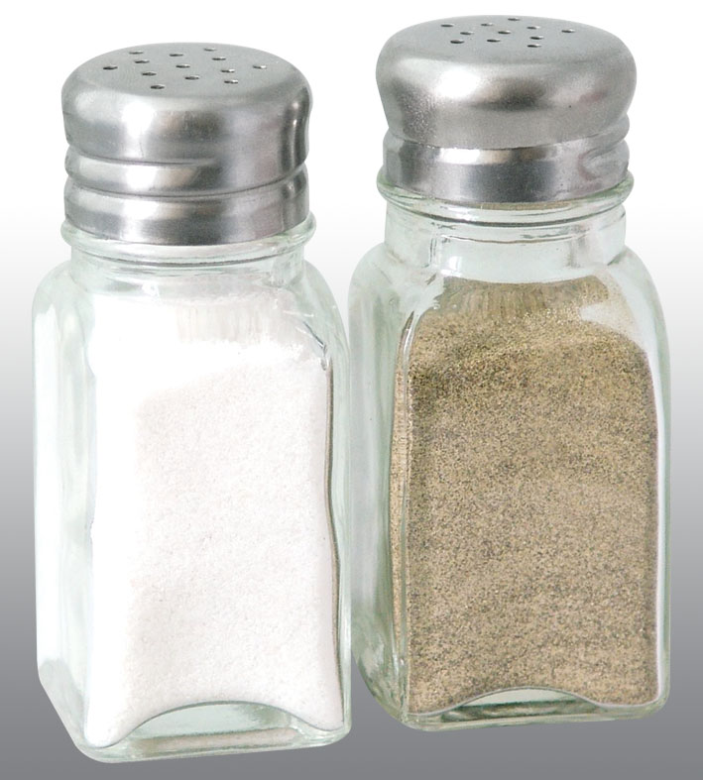
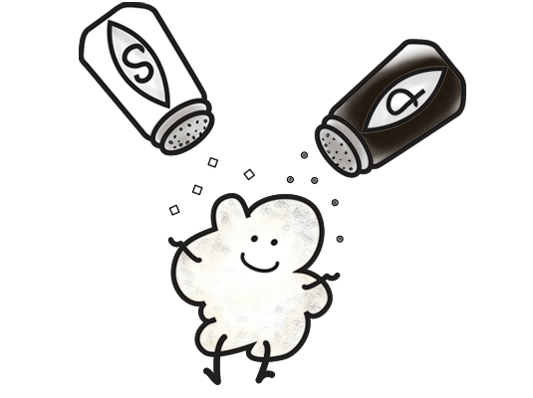



Salt and pepper

Slide 17



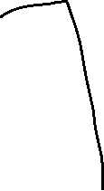
3.5.2 Order-Statistic (Nonlinear) Filters
Median Operation
Median { 3,2,1,5,4} = ?
{3,2,1,5,4} =>(queue)=> {1,2,3,4,5} => 3
[Programming of Median Filter]

Slide 18
3.5.2 Order-Statistic (Nonlinear) Filters

Slide 19





100 | 100 | 100 | 100 | 100 | 100 | 100 | 100
100 | 100 | 100 | 100 | 100 | 100 | 100 | 100
100 | 100 | 200 | 200 | 200 | 200 | 100 | 100
100 | 100 | 200 | 200 | 200 | 200 | 100 | 100
100 | 100 | 200 | 200 | 200 | 200 | 100 | 100
100 | 100 | 200 | 200 | 200 | 200 | 100 | 100
100 | 100 | 100 | 100 | 100 | 100 | 100 | 100
100 | 100 | 100 | 100 | 100 | 100 | 100 | 100

Slide 20

3.6 Sharpening Spatial Filters
3.6.1 Foundation
1D: derivative f sub x.

Slide 22
First derivative
Must be zero of the area of constant intensity;
Must be nonzero at the onset of an intensity step or ramp
Must nonzero along ramps.

Slide 23
Second derivative
Must be zero in constant area
Must be nonzero at the onset and end of an intensity step or ramp
Must be zero along ramps of constant slope

Slide 24
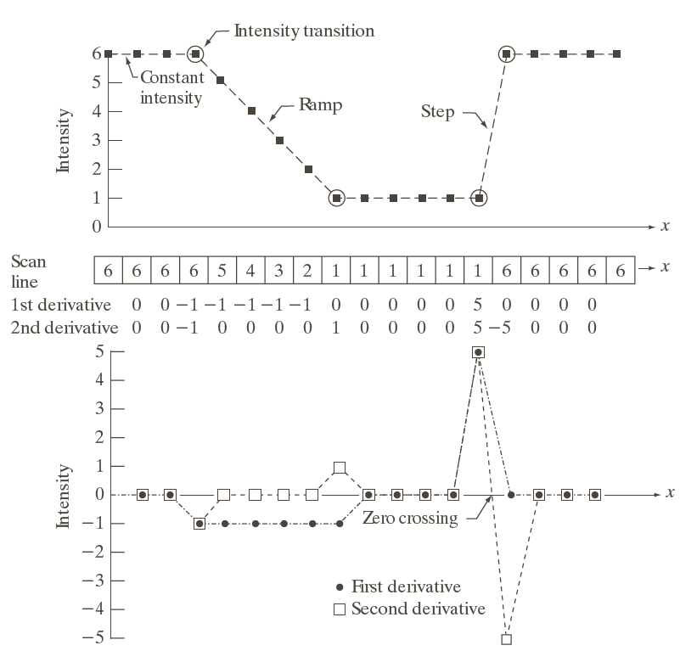
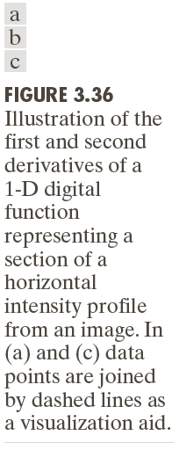
3.6.1 Foundation of Sharpening Spatial Filters

Slide 25
3.6 Sharpening Spatial Filters
2D:
Gx: partial derivative f sub x.
Gy: partial derivative f sub y

Slide 26
3.6.2 Laplacian (Second Derivative)

Slide 27
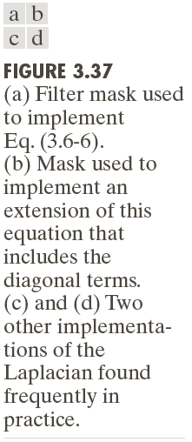
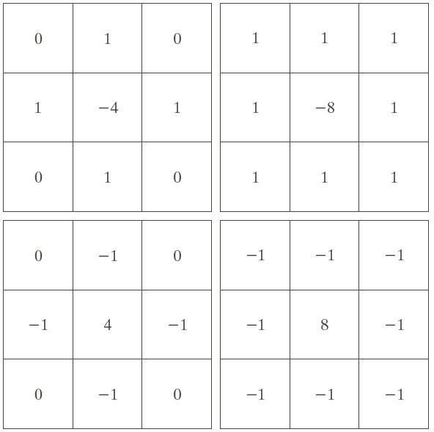
3.6.2 Laplacian (Second Derivative)

Slide 28

3.6.2 Laplacian (Second Derivative)
input | 4 | 4 | 4 | 7 | 7 | 7 | 7
1 -2 1 |  | 0 |  |  | 0 | 0
-1 2 -1 |  | 0 |  |  | 0 | 0

Slide 29


High Pass filter
[Programming of high pass filter]

Slide 30


3.6.2 Laplacian (Second Derivative)
[Programming of Laplacian]
Sharpening Filter

Slide 31
3.6.2 Laplacian (Second Derivative)
[Programming of Sharpening Filter]
 | -c
-c | 1+4*c | -c
 | -c

Slide 32
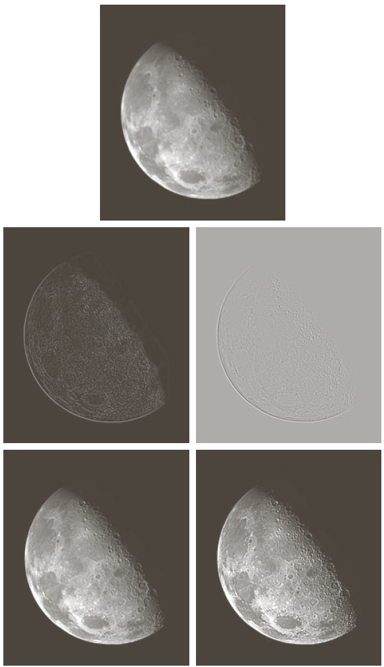

Slide 33
3.6.3 Unsharp Masking and Highboost Filtering
Unsharp Masking
Blur the original Image
Subtract the blurred image from the original (the resulting difference called the mask )
Add the mask to the original (10-10)

Slide 34


3.6.3 Unsharp Masking and Highboost Filtering

Slide 35
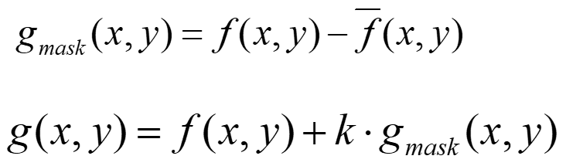

Slide 36



Slide 37
3.6.3 Unsharp Masking and Highboost Filtering

Slide 38
3.6.4 Using the First-Order Derivatives for (Nonlinear) Image Sharpening –The Gradient

Slide 39
Gradient
Magnitude of Gradient

Slide 40
Gradient
Approximate of magnitude (suitable computationaly)

Slide 41



First-Order Derivatives
Question: max value of

Slide 42
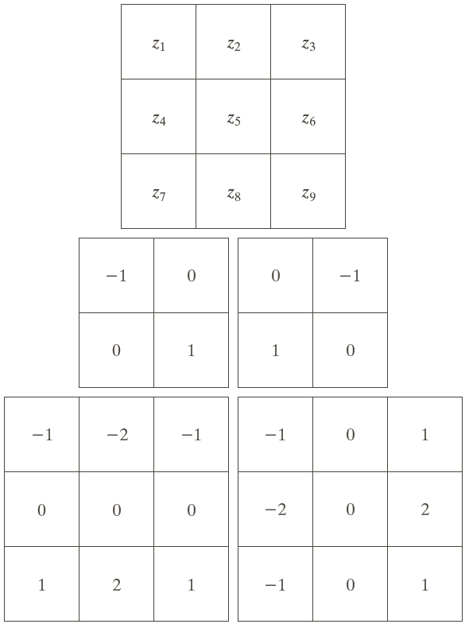
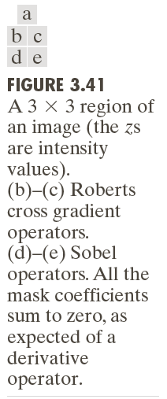







3.6.4 Using the First-Order Derivatives for (Nonlinear) Image Sharpening –The Gradient

Slide 43






Slide 44
Sobel mask
-1 | 0 | 1
-2 | 0 | 2
-1 | 0 | 1
Gx
Gy
-1 | -2 | -1
0 | 0 | 0
1 | 2 | 1
Y axis

Slide 45

Programming of Sobel

Slide 46
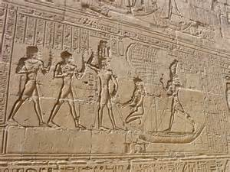
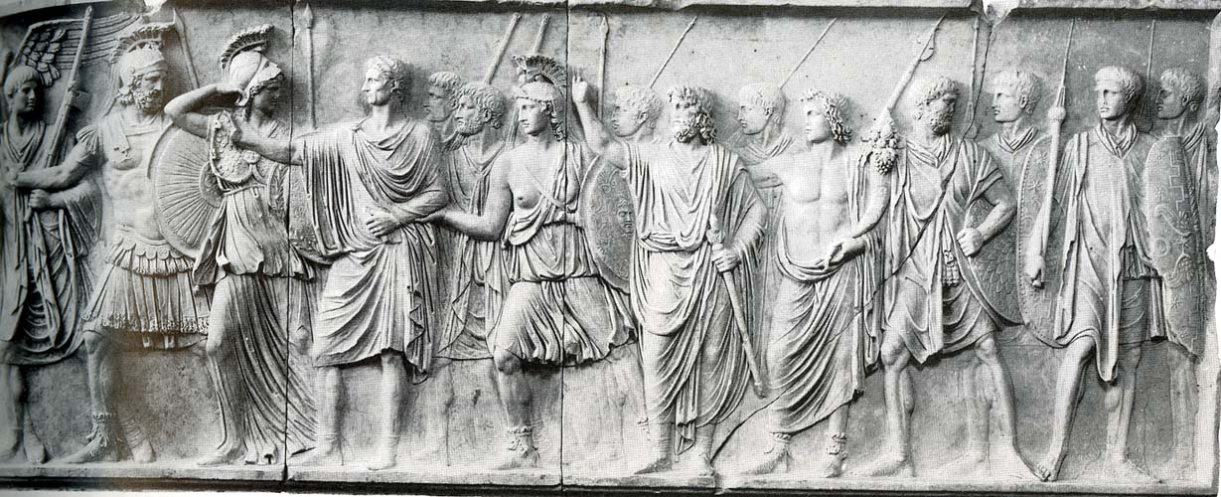
relief effect

Slide 47
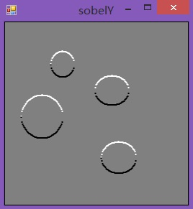
Sunken or Raised?

Slide 48





Slide 49

3.6.4 Using the First-Order Derivatives for (Nonlinear) Image Sharpening –The Gradient
[Programming]

Slide 50
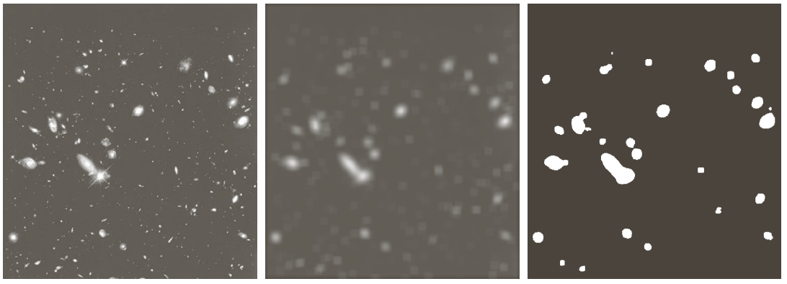
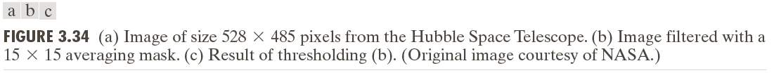
3.7 Combining Spatial Enhancement Methods

Slide 51
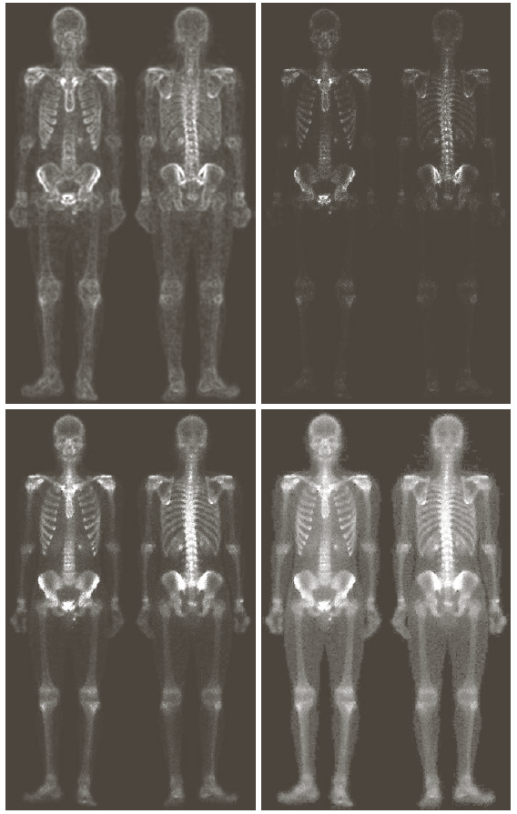
3.7 Combining Spatial Enhancement Methods

Slide 52
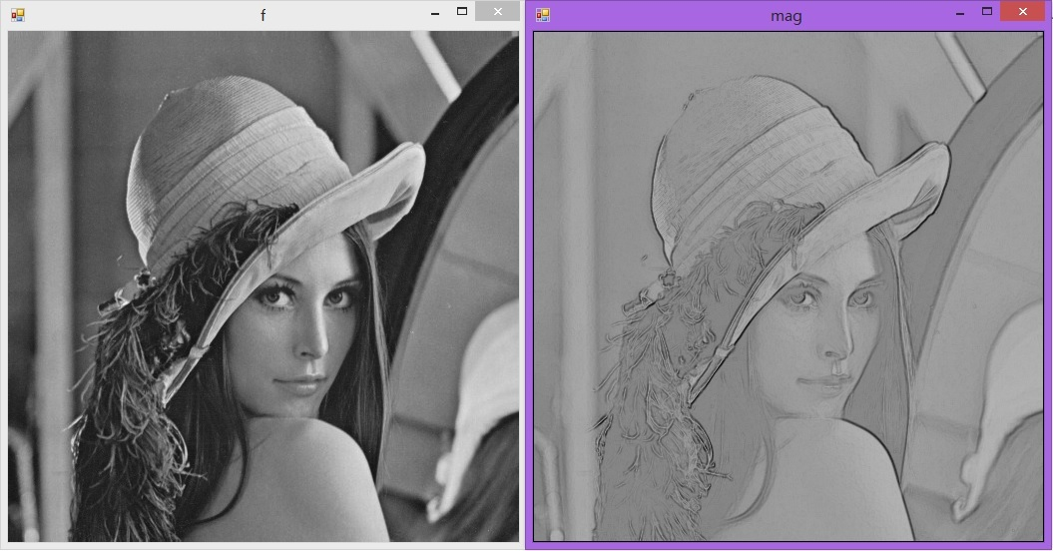
Algorithm Develop

